Slide 1
Bank Ruptcy
Presented by Group 4

Slide 2
Business Problem
In an environment of financial uncertainty and risks. Bankruptcy is a severe consequence where a company cannot meet its financial obligations, resulting in a loss for stakeholders, including creditors, investors, employees, and suppliers. Predicting bankruptcy early can provide opportunities for intervention, mitigating losses, and ensuring financial stability.

Slide 3
Objective
To develop a reliable model for predicting whether a business is likely to go bankrupt or not, based on specific financial, operational, and risk-related features.

Slide 4
INTRODUCTION
Bankruptcy occurs when businesses fail to meet financial obligations,
impacting stakeholders and the economy. Predicting bankruptcy early
helps mitigate risks and enables timely interventions. This project
develops a machine learning model to classify businesses as bankrupt
or non-bankrupt based on key risk factors. The model will be deployed
via a user-friendly web application for real-time predictions.

Slide 5
Project Architecture
Exploratory Data Analysis
Data Visualization
Data Preprocessing
Data Partitions
Model Building
Model Evaluation
Performance Comparison
Deployment

Slide 6
Data Set
Industrial Risk: Risk from the company's industry (low, medium, high).
Management Risk: Risk due to poor management decisions or inefficiency.
Financial Flexibility: How well the company manages debt and cash flow.
Credibility: The trustworthiness or reputation of the company.
Competitiveness: How well the company competes in the market.
Operating Risk: Risk from inefficiencies in business operations.
Bankruptcy (Target): Whether the company is bankrupt (1) or not bankrupt (0).

Slide 7
Data Description
Shape
250 Row’s
7 Column’s
Null Values
No Null Values
Data Types
Object
Duplicates
No Values

Slide 8
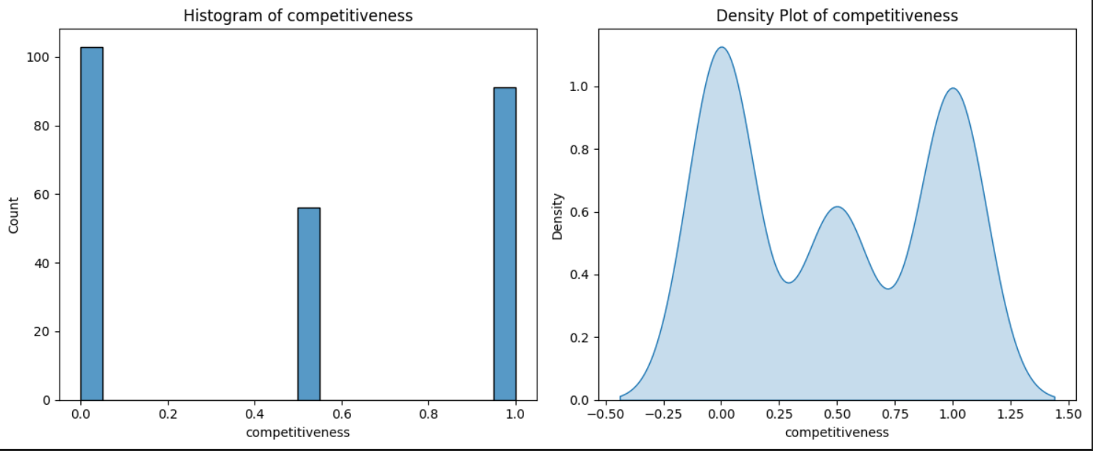
Data Visualization
- Histogram competitiveness from 0.0 to 1.0 and competitiveness for -0.50 to 1.50.
- Count for histogram is 0 to 100 and for density plot is 0.0 to 1.1.

Slide 9
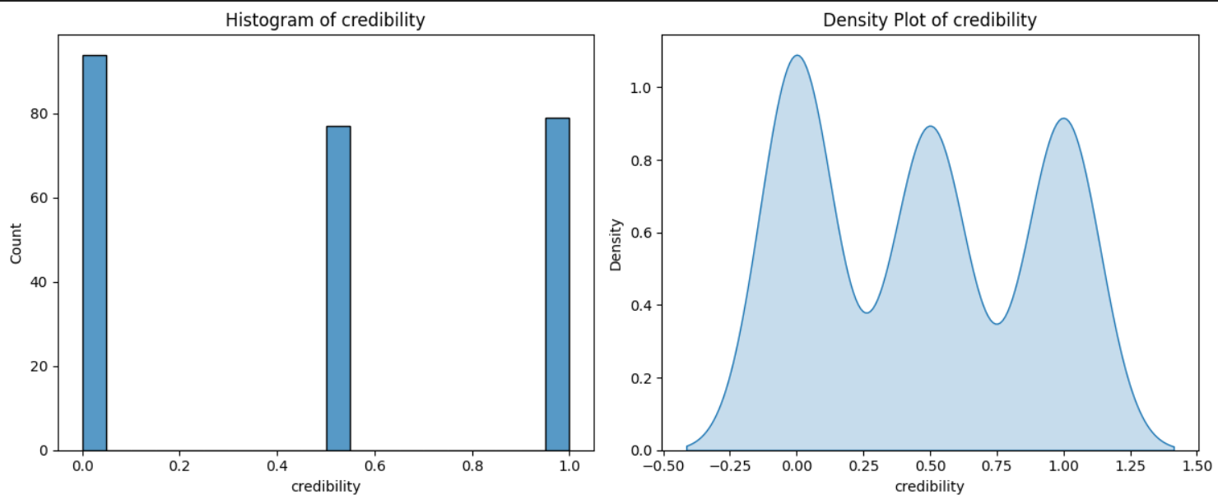
Data Visualization
- Histogram values span from 0.0 to 1.0 and credibility for -0.50 to 1.50.
- Count for histogram is 0 to 90 and for density plot is 0.0 to 1.0.

Slide 10
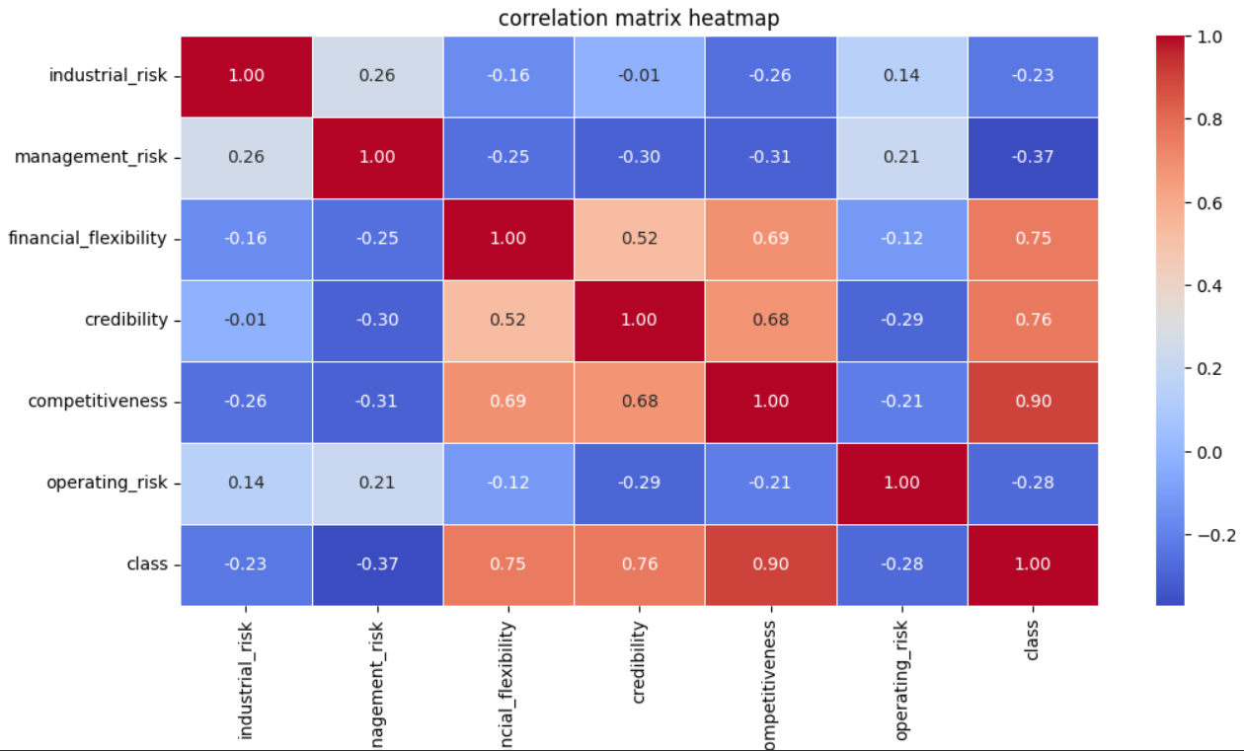
Data Visualization
The column competitiveness has strong positive relation.
The column management risk was negative correlation with target column class.

Slide 11
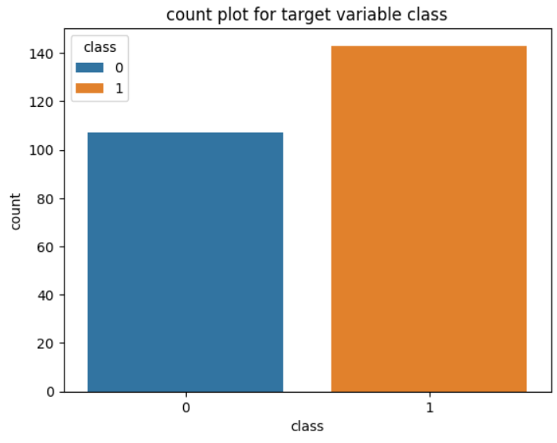
Data Visualization
- Target column `class’ has 100+ bankruptcy variable and 140 non-bankruptcy variables.

Slide 12
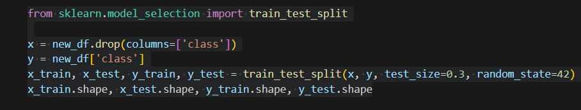
Train Test Split
.
The whole data set is splitted into two parts ranges at 20% and 80%.
30% of tested data is used for evaluating the model.
70% of training data is used for training the model.

Slide 13
Algorithms
We have used the balanced dataset to build the following models.
Linear regression
Decision Tree Classifier
Random Forest Classifier
Support Vector Regressor
XG Boost Regressor
KNeighbors Classifier

Slide 14
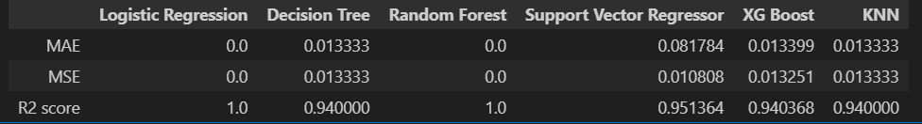
Models
.
- As we have better R2 score and medium error for support vector regressor.

Slide 15
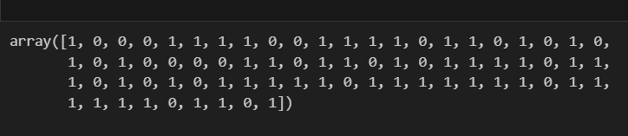
Prediction
b
In the X test predictions, we used the target column. The target column has only two values:
0 for Non-bankruptcy
1 for Bankruptcy
This is because the target column has only two options: Bankruptcy or Non-bankruptcy.
.

Slide 16
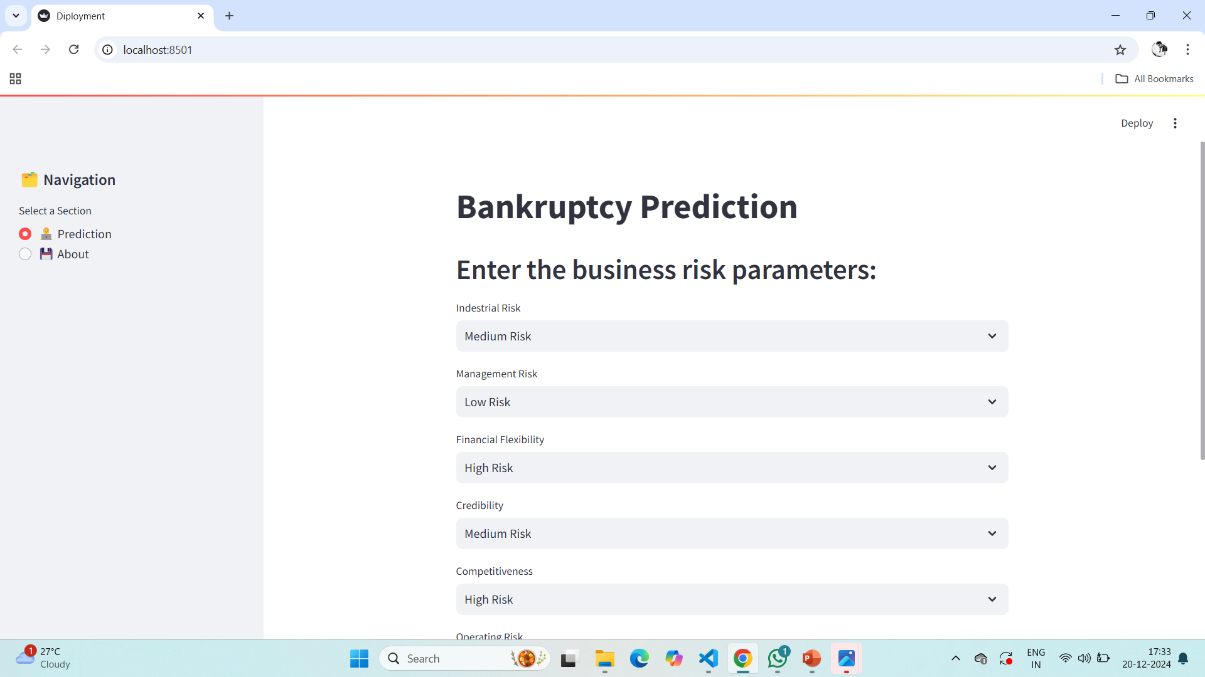
Streamlit Web App

Slide 17
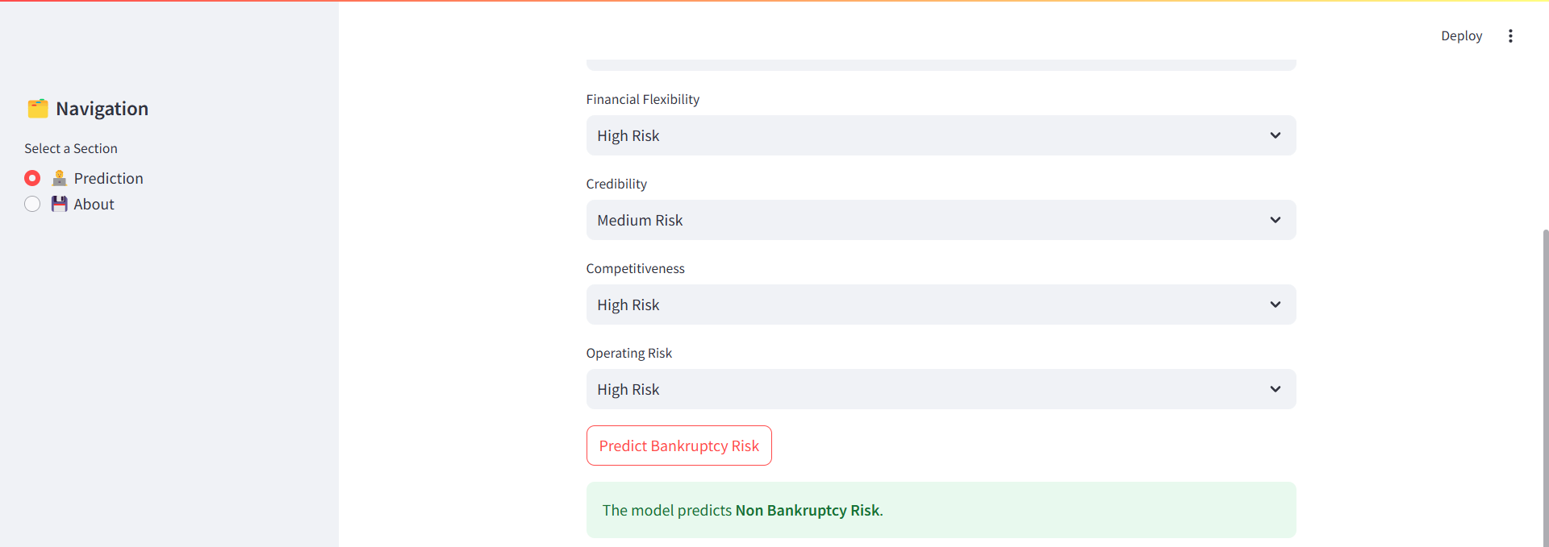
Prediction

Slide 18
Key Challenges
Data Quality and Availability:
Financial data is sensitive and may not always be accurate or complete.
Smaller businesses might lack detailed reporting.
Complexity of Financial Indicators:
Bankruptcy can result from a combination of factors like operational in
efficiencies, external economic conditions, and poor management.
Dynamic Economic Conditions:
Models must adapt to changing market trends and economic indicators.

Slide 19
Over Come
Using machine learning to create a binary classification model that predicts bankruptcy (Yes/No) based on:
Industrial Risk: Economic conditions and sector-specific risks.
Management Risk: Effectiveness and reliability of leadership.
Financial Flexibility: Ability to manage debts and secure funding.
Credibility: Reputation and trustworthiness in the market.
Competitiveness: Market position relative to competitors.
Operating Risk: Day-to-day operational inefficiencies.

Slide 20
THANK
YOU

